Slide 1
Rev. Proc. 93-27
Sec. 4.01 Other than as provided below, if a person receives a profits interest for the provision of services to or for the benefit of a partnership in a partner capacity or in anticipation of being a partner, the Internal Revenue Service will not treat the receipt of such an interest as a taxable event for the partner or the partnership.

Slide 2
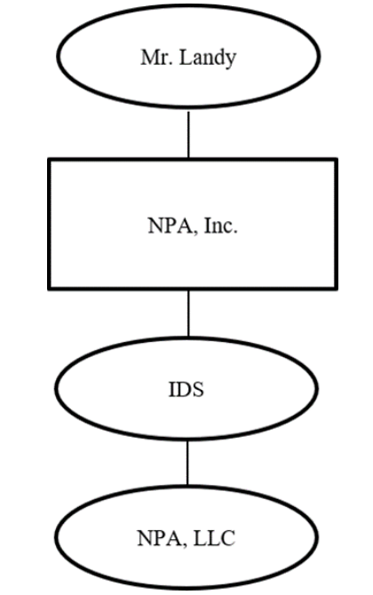
ES NPA Holding LLC v. CIR (T.C. Mem. 2023-55)
Landy owned consumer loan businesses through various wholly owned entities:
NPA, Inc., Community Credit Services, Inc., National Opportunities Unlimited, Inc., and American Consumer Credit, LLC
On 9/27/11 NPA, Inc. formed two LLCs: IDS and NPA, LLC.
IDS had two classes of membership units: B and C
NPA, LLC had three classes of units: A, B, and C
IDS LLC agreement: class B and class C units in IDS track the class B and class C units in NPA, LLC--owner of IDS class B (class C) units was entitled to 100% of the payments received by IDS because of its ownership of NPA, LLC class B (class C) units
On 10/13/11, NPA, Inc. contributed substantially all of its business assets to NPA, LLC in exchange for all three classes of units (classes A, B, and C) in NPA, LLC. NPA, Inc. then contributed all three classes of units (classes A, B, and C) in NPA, LLC to IDS as a capital contribution to IDS.

Slide 3
ES NPA Holding LLC v. CIR (T.C. Mem. 2023-55)
October 14, 2011, NPA, LLC entered into revenue-sharing agreements with the consumer loan businesses, CCS, NOU, and ACC.
NPA Investors, LP (NPA Investors) purchased all of NPA, LLC’s class A units from IDS for $14,502,436.
ES NPA exercised a call option granted by NPA, Inc., acquired all of the IDS class C units in exchange for ES NPA’s payment to NPA, Inc. of $100,000 and services provided or to be provided.
ES NPA agreed to provide the following services to NPA, Inc. for the option to pay $100,000 to NPA, Inc. to acquire all of the class C units in IDS (which reflected an indirect interest in the class C units of NPA, LLC): “strategic advice for the purpose of enhancing the performance of [NPA Inc.’s] business and to assemble an investor group that would purchase 40 [sic] percent of [NPA Inc.’s] business for approximately $21 million.” The call option agreement also provides that ES NPA is hereby given “an option . . . to purchase all of the Class C Units . . . from [IDS]” and is dated October 14, 2011.

Slide 4
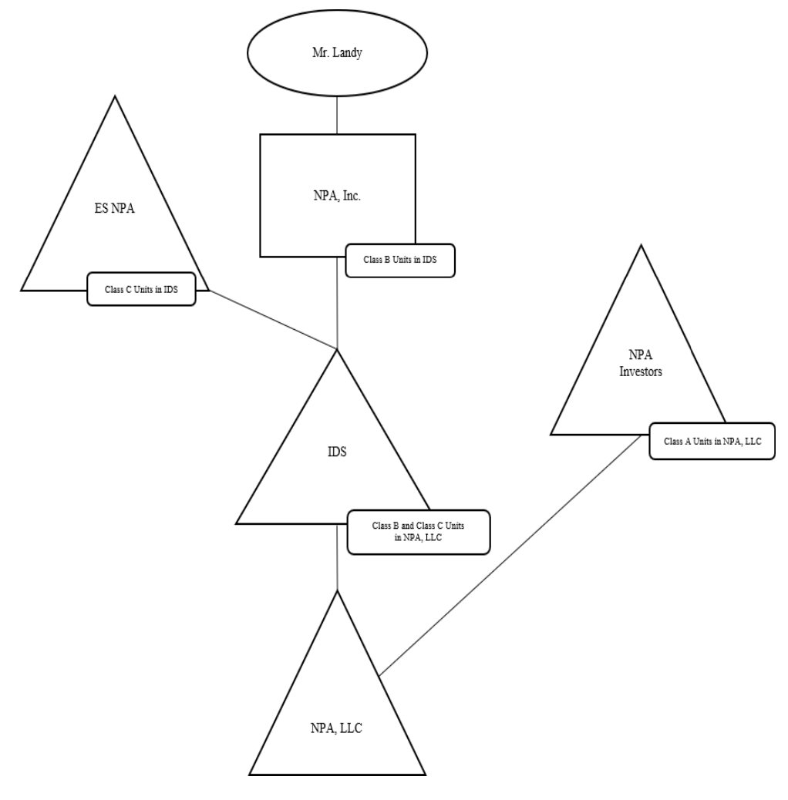
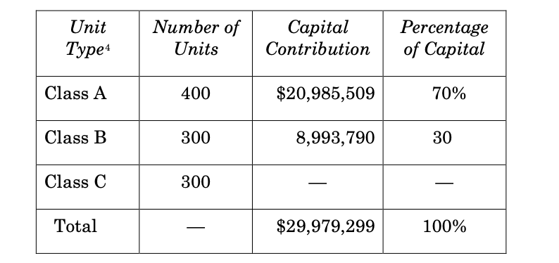
ES NPA Holding LLC v. CIR (T.C. Mem. 2023-55)

Slide 5
ES NPA Holding LLC v. CIR (T.C. Mem. 2023-55)
Issue: does ES NPA’s indirect receipt of the class C units in NPA, LLC qualify as a profits interest in Rev. Proc. 93-27?
IRS:
Rev. Proc. 93-27 doesn’t apply because ES NPA didn’t provide services to IDS.
ES NPA received a capital interest in IDS w/ a FMV of 12MM.
CT:
ES NPA provided services to NPA, Inc. in X for class C IDS units, which were identical to class C units in NPA, LLC.
Evidence that ES NPA provided services to or for the benefit of NPA LLC…It is of no material consequence that ES NPA’s interest in NPA, LLC is held indirectly through IDS, which is a mere conduit since the liquidation rights in the class C units in both IDS and NPA, LLC are identical.
Class C IDS unit was not a capital interest? Why not?

